Slide 1
Angular JS Service
Unit-5

Slide 2
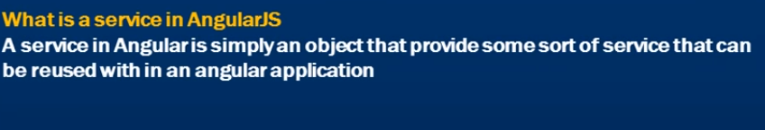
What is Angular JS Service

Slide 3

Why do we need Services
Angular JS Supports “Separation of Concerns” Using Services.
Can make our code with Single Responsibility.
Services in Javascript function.
Services are injected using dependency Injection.

Slide 4
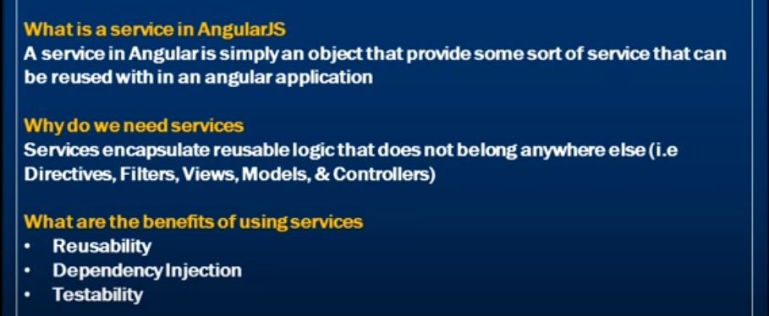

Slide 5
Types of Angular JS Services
Angular JS Built in Services
2. Customized Angular JS Services

Slide 6
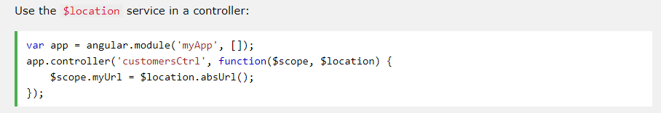
Angular JS Built in Services
AngularJS has about 30 built-in services. One of them is the $location service.
The $location service has methods which return information about the location of the current web page:

Slide 7
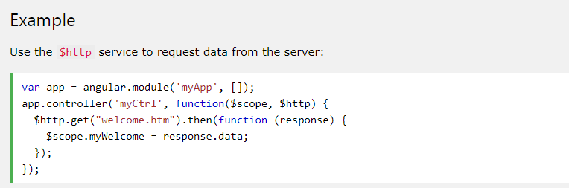
Angular JS Built in Services
The $http Service
The $http service is one of the most common used services in AngularJS applications. The service makes a request to the server, and lets your application handle the response.

Slide 8
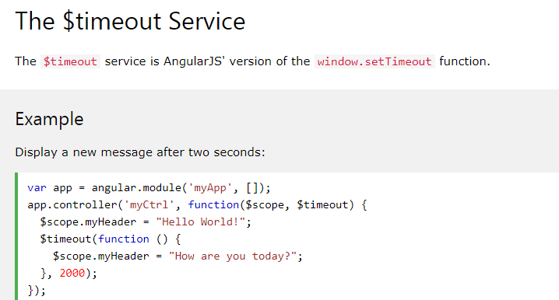
Angular JS Built in Services

Slide 9
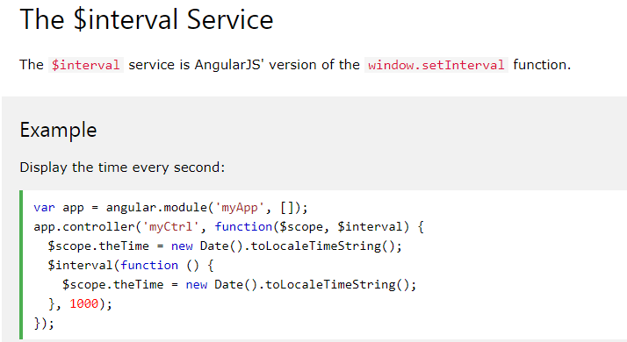
Angular JS Built in Services

Slide 10
Steps in Custom Creating Service
Create HTML Page
Add Angular JS Directive
Define Controller for Custom service.
Either you can go with
Service method for creating customizes service.
Factory method for creating customizes service.

Slide 11
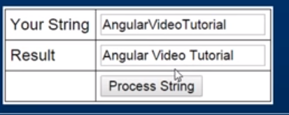
Creating Custom Service

Slide 12
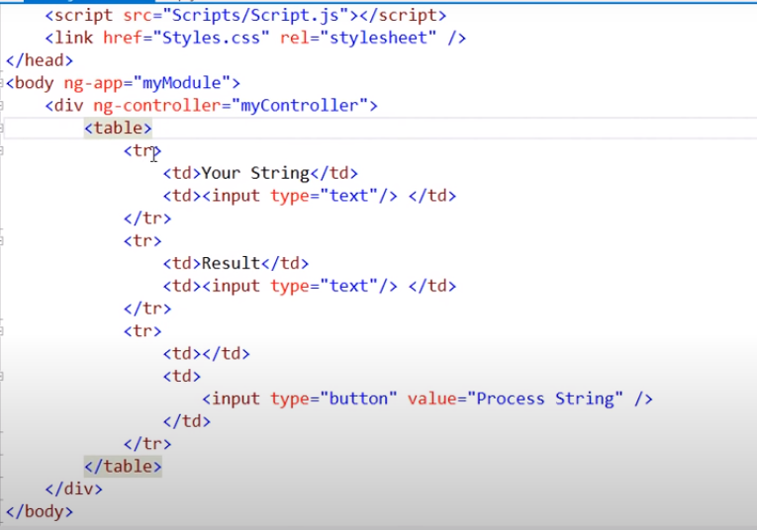
Step1- Create HTML Page

Slide 13
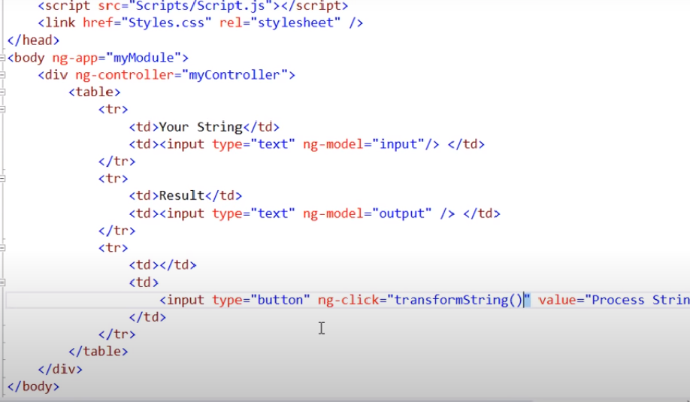
Step2-Add Angular JS Directives

Slide 14
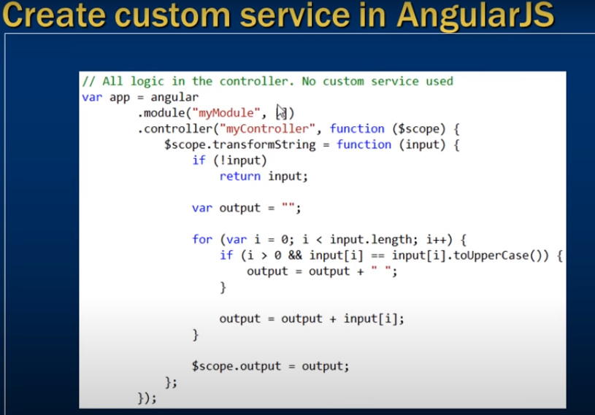
Step3:Define Controller for Custom Service

Slide 15
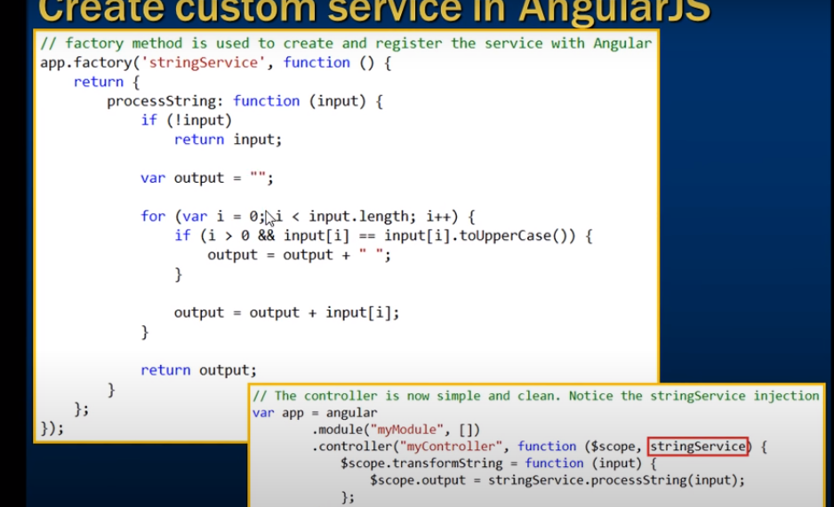
Factory method is used to create service

